Slide 1
Page Setup
Set up the first page of every lesson like this and rule a column line for every page after the first page that is used during the lesson.
Focus: State the Chapter Number, Title and the page numbers (3 lines).
Keywords: During the lesson write out your own keywords used during the lesson. (8 lines)
Context: During the lesson write in this section what this topic relates to in the ‘real’ world. How is this content used to better society? (5 lines)

Slide 2
Pre-Physics
Year 11

Slide 3
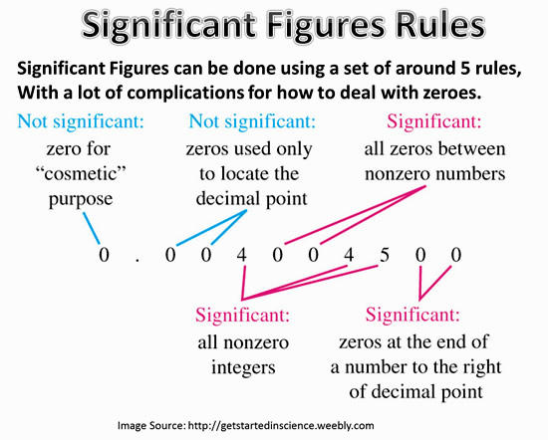
Significant Figures

Slide 4
Significant Figures
Generally in Year 11 I am not strict with how many significant figures are used (i.e. unless specified in the test, marks will not be lost for incorrect use, as you need to become comfortable with using them before going into Year 12).
As a rule of thumb use 3 significant figures for the final answer.

Slide 5
Significant Figures Examples
Convert to 3 significant figures
18521 kg
2513450 m
0.0025466 s
18500 kg
2510000 m
0.00255 s

Slide 6
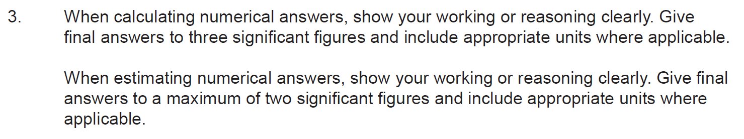
Candidate Instructions from Year 12 WACE Paper

Slide 7
Scientific Notation
Again, generally not strict with when you choose to use scientific notation in Year 11 (i.e. unless specified in the test, marks will not be lost for incorrect use, as you need to become comfortable with using them before going into Year 12).
As a rule of thumb with values between 0.01 and 1000, there is no need to use scientific notation. However, strongly recommend you practice with any value.

Slide 8
Scientific Notation Examples
Convert to scientific notation and 2 significant figures
18521 kg
2513450 m
0.0025466 s
1.9 x 10⁴ kg
2.5 x 10⁶ m
2.5 x 10⁻³ s

Slide 9
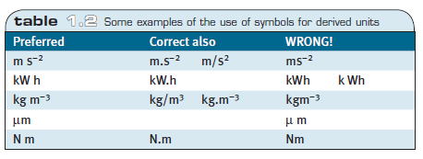
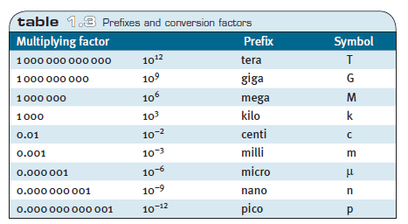
Use of Symbols

Slide 10
SI Units
SI units (standard international units)
Unless specified otherwise in the question, always use
kilograms
metres
seconds
metres per second
newtons

Slide 11
Basic S.I. Units
Convert the following to SI units (2 s.f. & sc. not.)
100 km
0.6 cm
40 g
1.0 x 10⁵ m
6.0 x 10⁻³ m
4.0 x 10⁻² kg

Slide 12
Basic Rearranging and Solving
Solve showing full working.
x + 5 = 11
a – 8 = -4
b + 4 = -11
x = 6
a = 4
b = -15

Slide 13
Basic Logarithms
Rules
log₁₀(mn) = log₁₀(m) + log₁₀(n)
log₁₀(^{m}/_{n}) = log₁₀(m) – log₁₀(n)
log₁₀(m^{n}) = n · log₁₀(m)
log₁₀(1) = 0
log₁₀(10) = 1
log₁₀(10^{n}) = n

Slide 14
Basic Logs
Expand the following showing full working.
log₁₀(2x)
log₁₀(2x) = log₁₀(2) + log₁₀(x)
log₁₀( ¹⁶/_{x} )
log₁₀( ¹⁶/_{x} ) = log₁₀(16) - log₁₀(x)

Slide 15

Basic Logs
Expand the following showing full working.
log₁₀(x³)
log₁₀(x³) = 3 · log₁₀(x) = 3log₁₀(x)
log₁₀($\frac{{8x}^{4}}{5}$)
log₁₀($\frac{{8x}^{4}}{5}$) = log₁₀(8x⁴) – log₁₀(5)
= log₁₀(8) + log₁₀(x⁴) – log₁₀(5)
= log₁₀(8) + 4 · log₁₀(x) – log₁₀(5)

Slide 16
Basic Indices (Exponential)
Rules
a ^{n} · a ^{m} = a ^{n+m}
a ^{n} · b ^{n} = (a · b) ^{n}
a ^{n} / a ^{m} = a ^{n-m}
a ^{n} / b ^{n} = (a / b) ^{n}
(b^{n})^{m} = b^{n·m}
b^{1/n} = ^{n}√b
b^{-n} = 1 / b^{n}
b⁰ = 1

Slide 17
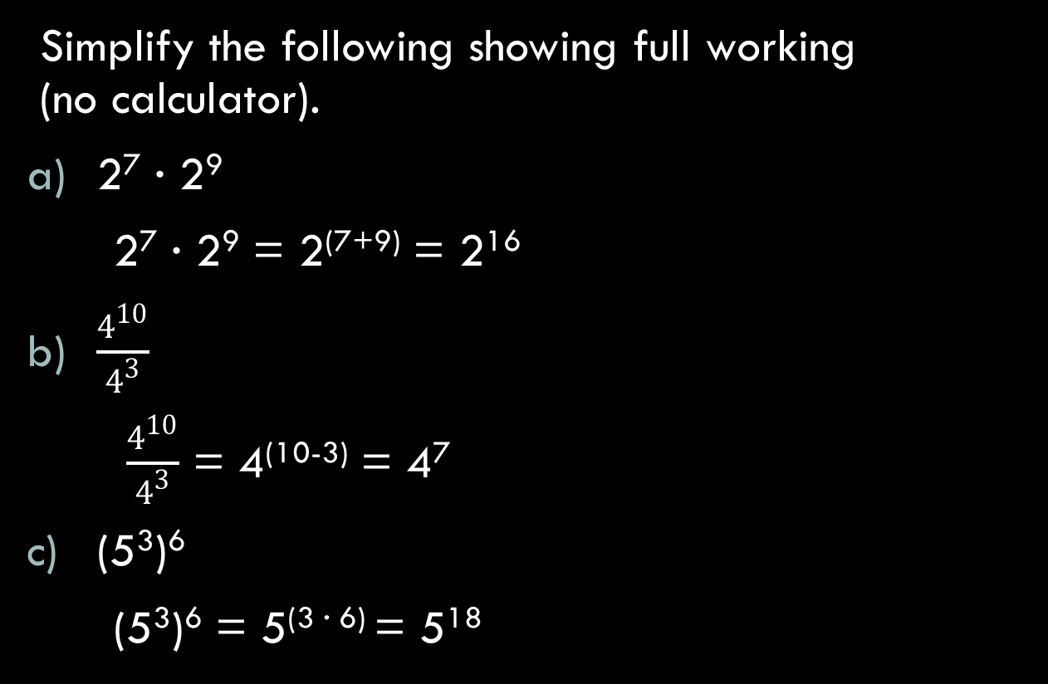
Basic Indices
Simplify the following showing full working (no calculator).
2⁷ · 2⁹
2⁷ · 2⁹ = 2⁽⁷⁺⁹⁾ = 2¹⁶
$\frac{4^{10}}{4^{3}}$
$\frac{4^{10}}{4^{3}}$ = 4⁽¹⁰⁻³⁾ = 4⁷
(5³)⁶
(5³)⁶ = 5^{(3 · 6)} = 5¹⁸

Slide 18
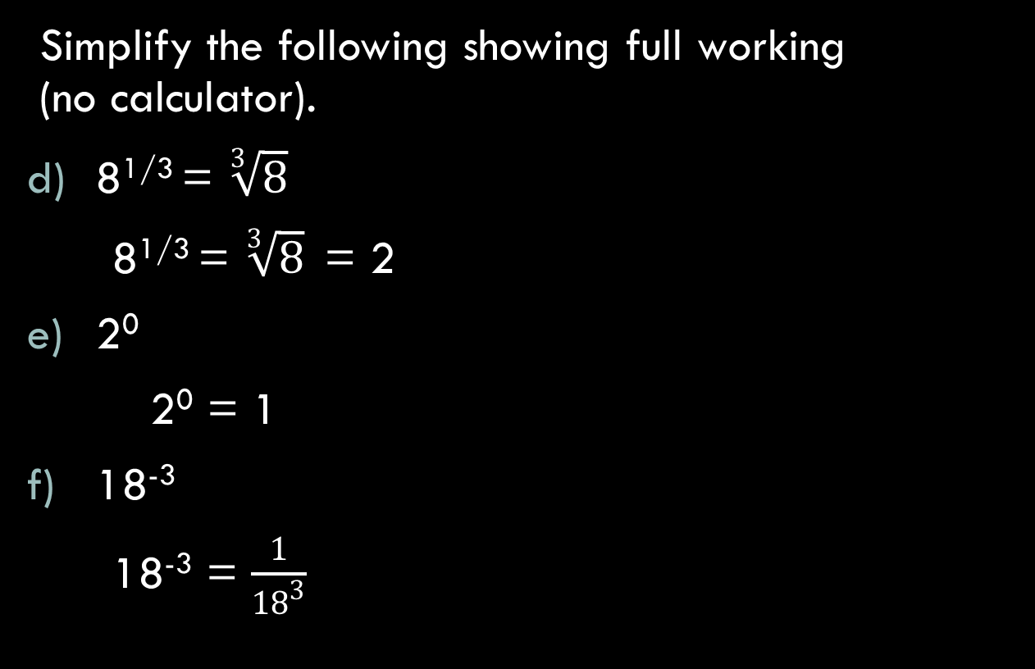
Basic Indices
Simplify the following showing full working (no calculator).
8^{1/3} = $\sqrt[3]{8}$
8^{1/3} = $\sqrt[3]{8}$ = 2
2⁰
2⁰ = 1
18⁻³
18⁻³ = $\frac{1}{{18}^{3}}$

Slide 19
Solving equations using logarithms and indices
Solve the following (using a calculator).
5000 = 3^{b}
log₁₀(5000) = log₁₀(3^{b})
= b · log₁₀(3)
b = log₁₀(5000)
log₁₀(3)
= 7.753

Slide 20
Solving equations using logarithms and indices
Solve the following (using a calculator).
300 = 5^{n}
log₁₀(300) = log₁₀(5^{n})
= n · log₁₀(5)
n = log₁₀(300)
log₁₀(5)
= 3.54

